Slide 1
2013 Poster Competition
Sponsored by JSA
Notes:
Red Title Page

Slide 2
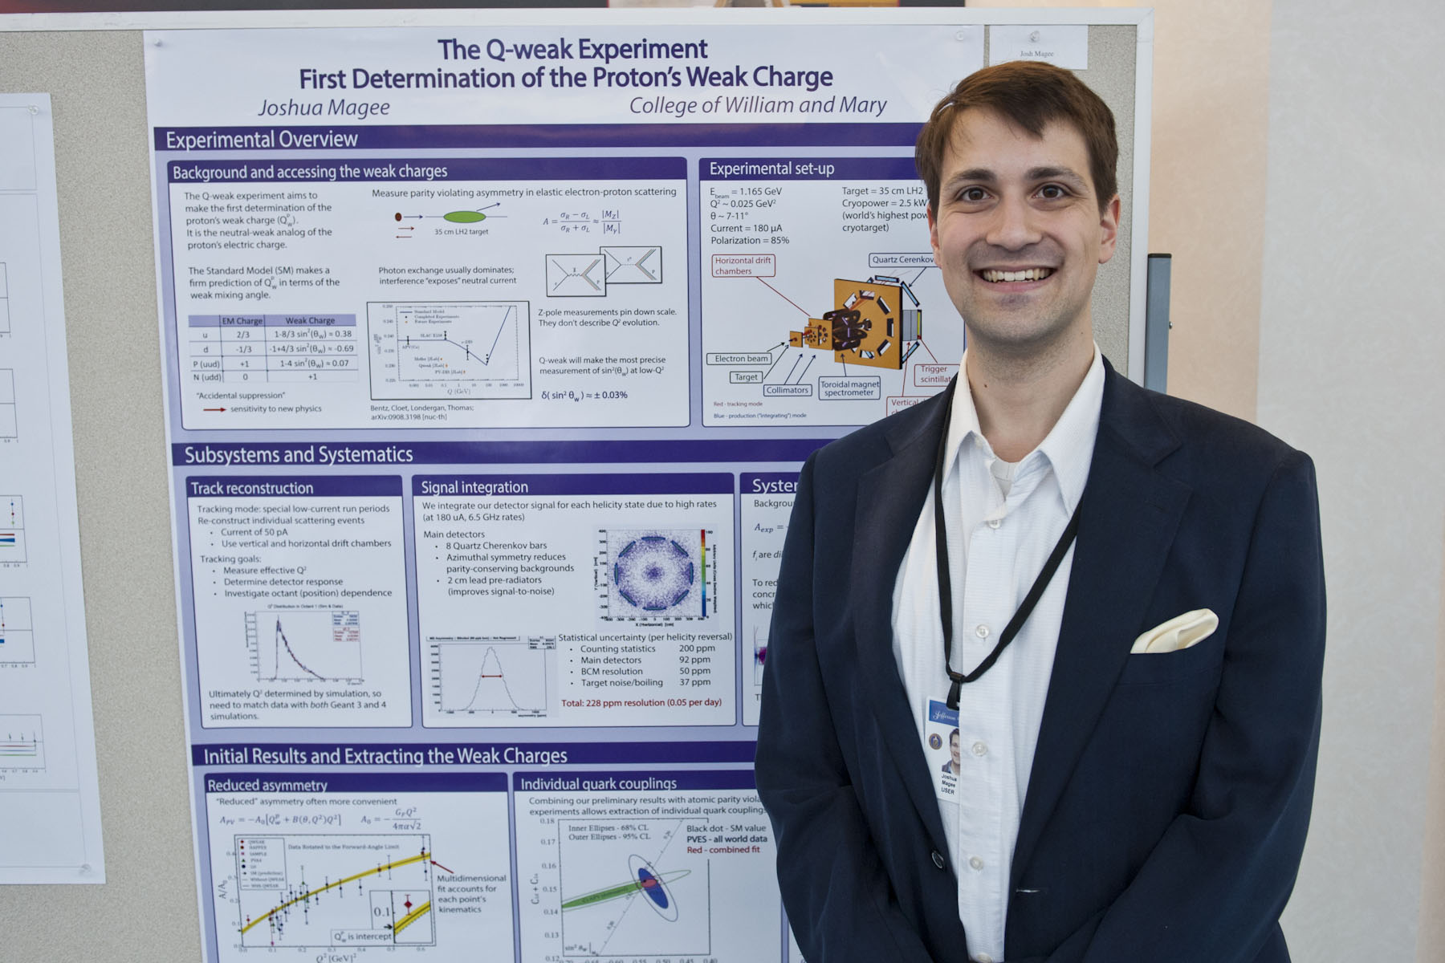
3rd Place
Josh Magee
Notes:
Red Interior Page Design 1

Slide 3
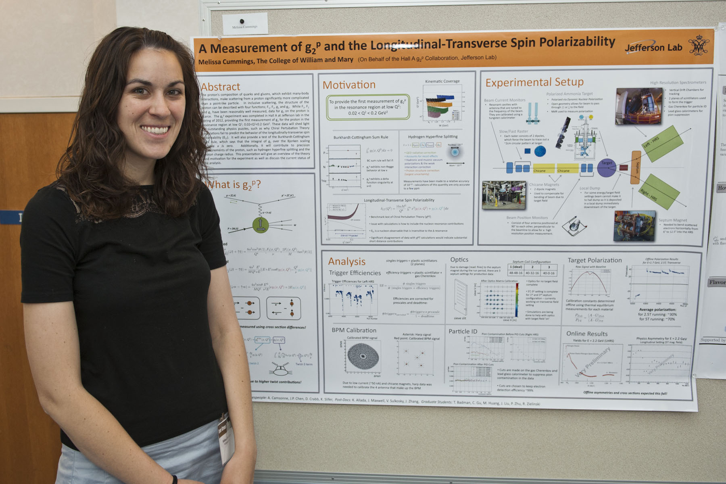
2nd Place
Melissa Cummings
Notes:
Red Interior Page Design 2

Slide 4
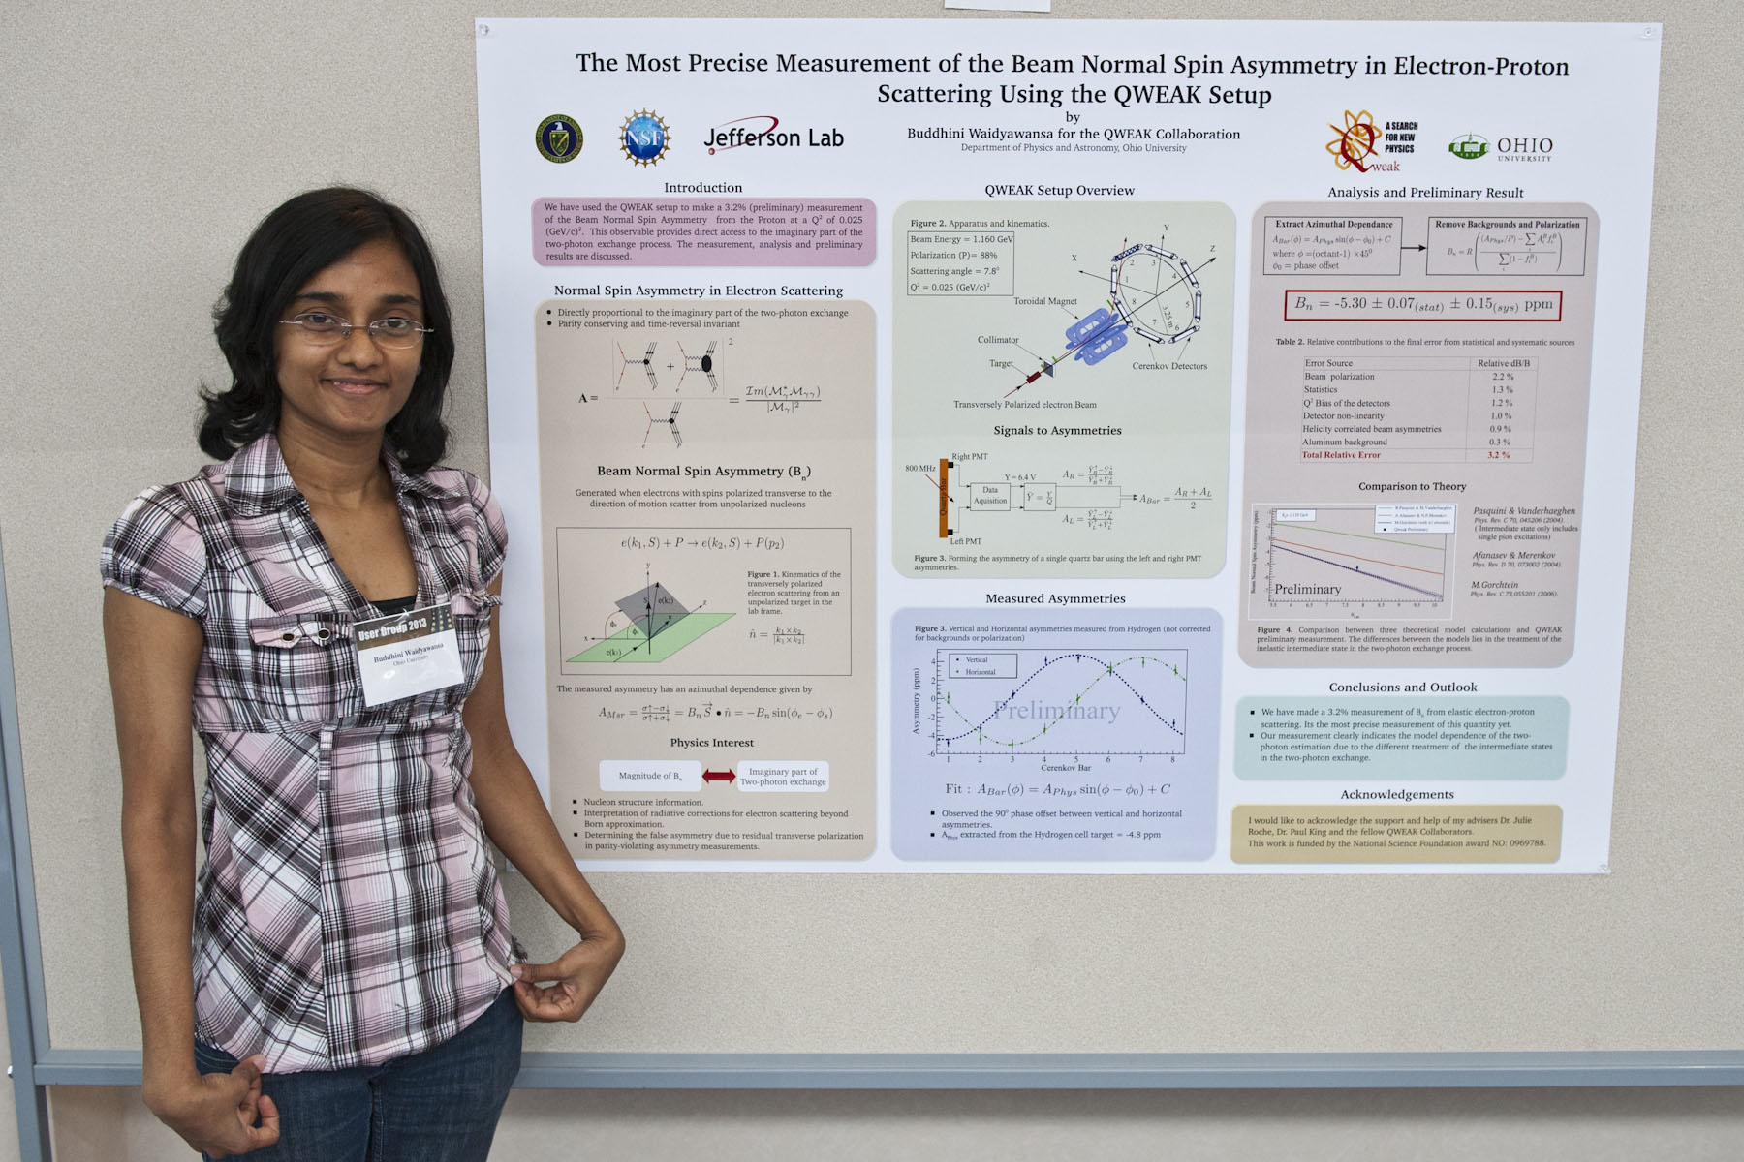
1st Place
Buddhini Waidyawansa
Notes:
Red Interior Page Design 2

Slide 5
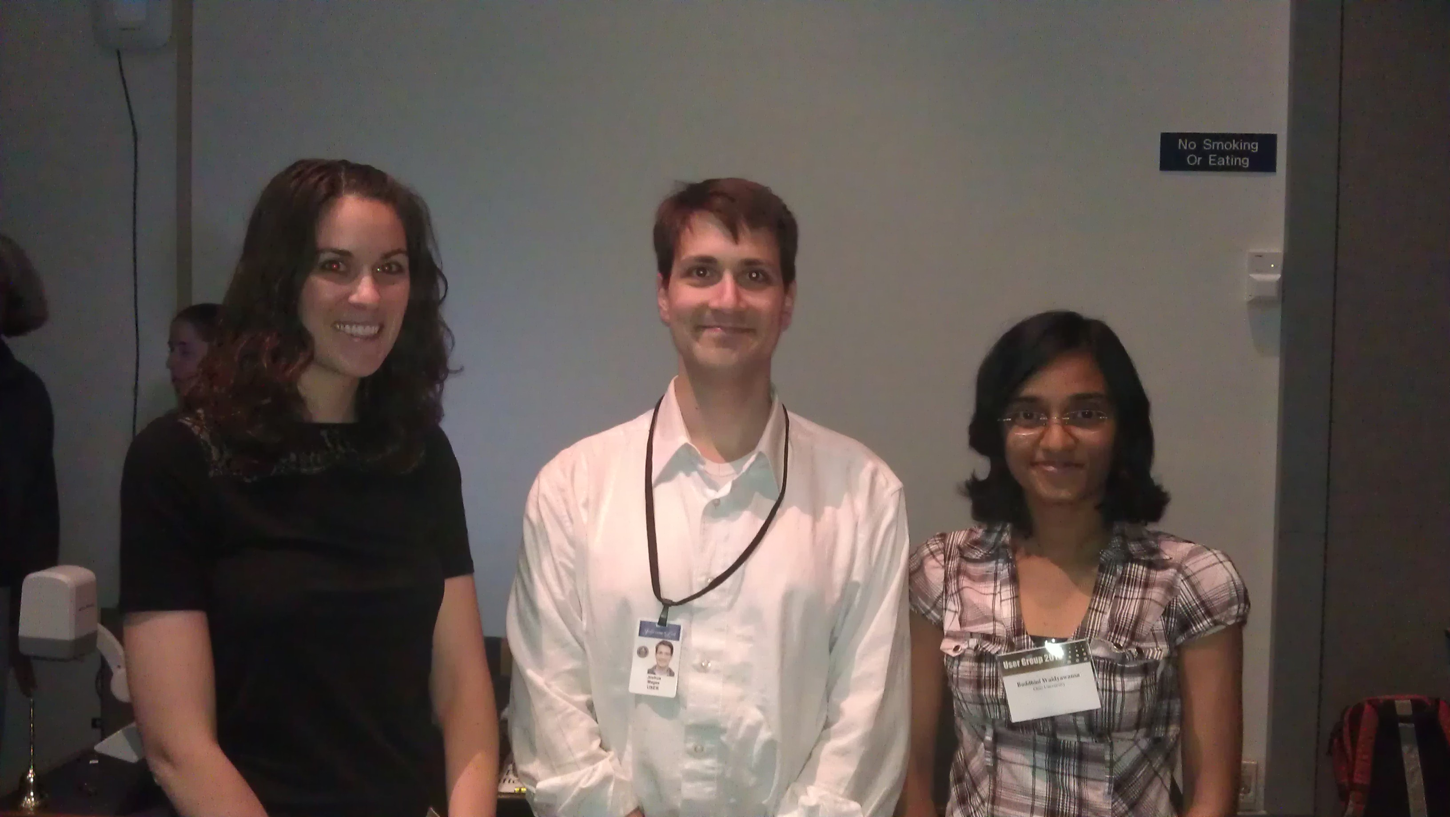
2013 Winners
Notes:
Red Interior Page Design 2

Slide 6
Thank you to those who participated and to Elton Smith and Steffen Strauch for judging!
Notes:
Red Interior Page Design 2

